Slide 1
SSDs
State Machine Diagrams
Operational Contracts
Nesneye Dayalı Analiz ve Tasarım Dersi
Dr. Ali Murat Tiryaki

Slide 2
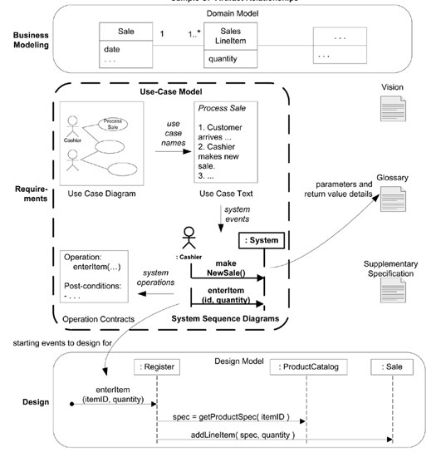

Slide 3
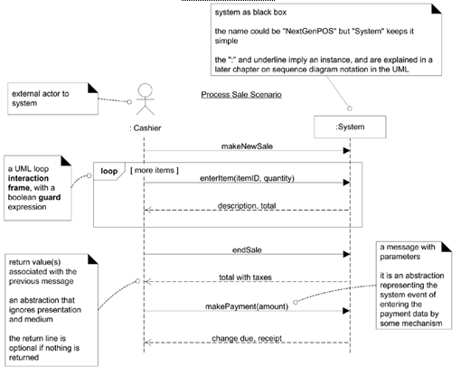
SSD for a Process Sale scenario

Slide 4
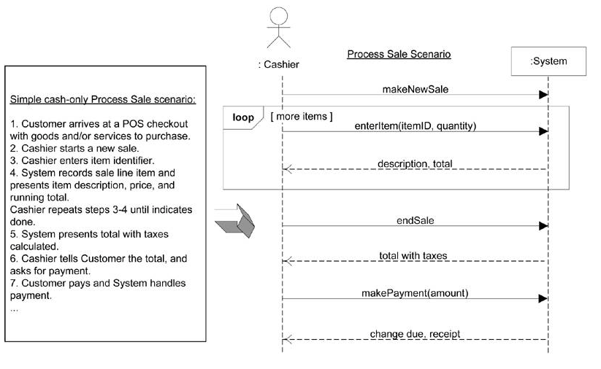
SSDs & use cases

Slide 5
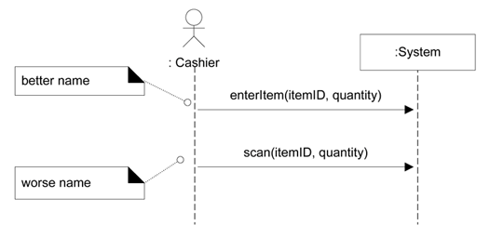
Event and Operation Names

Slide 6
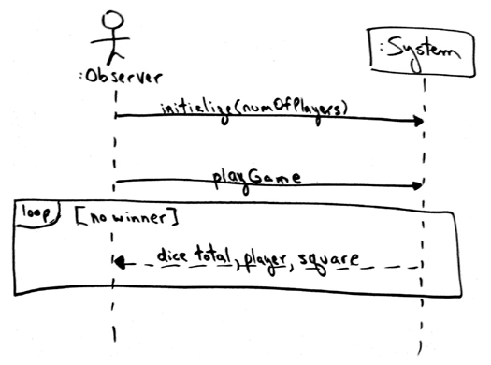
SSD for a Play Monopoly Game scenario

Slide 7
UP Phases
Inception SSDs are not usually motivated in inception,
Elaboration Most SSDs are created during elaboration,

Slide 8
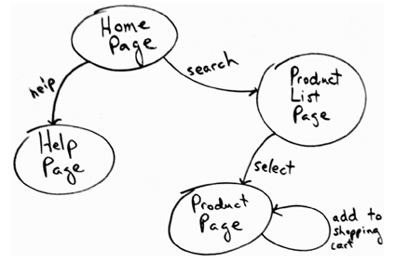
Applying a state machine to Web page navigation modeling

Slide 9
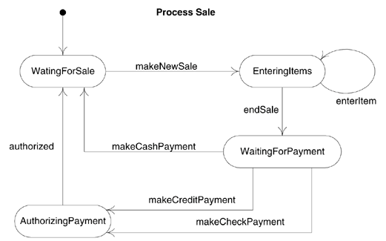
NextGen Use Case State Machine Diagram

Slide 10
Operation Contracts
Operation contracts use a pre- and post-condition form to describe detailed changes to objects in a domain model, as the result of a system operation.
They may be considered part of the UP Use-Case Model

Slide 11
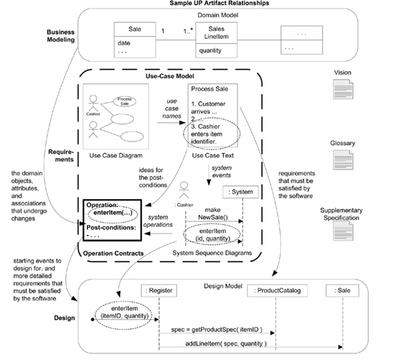
Sample UP artifact influence

Slide 12
Contract CO2: enterItem
Operation: | enterItem(itemID: ItemID, quantity: integer)
Cross References: | Use Cases: Process Sale
Preconditions: | There is a sale underway.
Postconditions: | A SalesLineItem instance sli was created (instance creation). - sli was associated with the current Sale (association formed). - sli.quantity became quantity (attribute modification). - sli was associated with a ProductDescription, based on itemID match (association formed).

Slide 13
The Sections of a Contract
Operation: | Name of operation, and parameters
Cross References: | Use cases this operation can occur within
Preconditions: | Noteworthy assumptions about the state of the system or objects in the Domain Model before execution of the operation. These are non-trivial assumptions the reader should be told.
Postconditions: | This is the most important section. The state of objects in the Domain Model after completion of the operation. Discussed in detail in a following section.

Slide 14
What is a System Operation?
Operation contracts may be defined for system operations that the system as a black box component offers in its public interface.
System operations can be identified while sketching SSDs,
To be more precise, the SSDs show system events or I/O messages relative to the system. Input system events imply the system has system operations to handle the events, just as an OO message is handled by an OO method

Slide 15
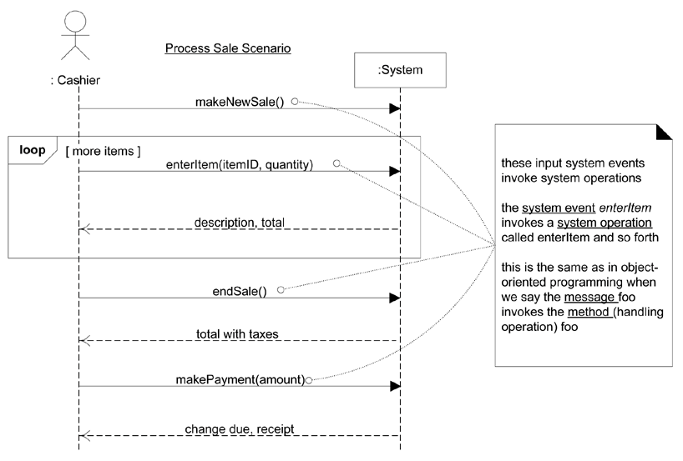
SSD. System operations handle input system events

Slide 16
Postconditions
Instance creation and deletion.
Attribute change of value.
Associations (to be precise, UML links) formed and broken.

Slide 17
How to Write a Postcondition?
(better) A SalesLineItem was created.
rather than
(worse) Create a SalesLineItem, or, A SalesLineItem is created.

Slide 18
Example: enterItem Postconditions
Instance Creation and Deletion
  A SalesLineItem instance sli was created (instance creation).
Attribute Modification
  sli.quantity became quantity (attribute modification).
Associations Formed and Broken
  sli was associated with the current Sale (association formed).
  sli was associated with a ProductDescription, based on itemID match (association formed).

Slide 19
How to Create and Write Contracts
Identify system operations from the SSDs.
For system operations that are complex and perhaps subtle in their results, or which are not clear in the use case, construct a contract.
To describe the postconditions, use the following categories:
  instance creation and deletion
  attribute modification
  associations formed and broken

Slide 20
What's the Most Common Mistake?
The most common problem is forgetting to include the forming of associations.
Particularly when new instances are created, it is very likely that associations to several objects need be established.

Slide 21
Contract CO1: makeNewSale
Operation: | makeNewSale()
Cross References: | Use Cases: Process Sale
Preconditions: | none
Postconditions: | A Sale instance s was created (instance creation). s was associated with a Register (association formed). Attributes of s were initialized.

Slide 22
Contract CO2: enterItem
Operation: | enterItem(itemID: ItemID, quantity: integer)
Cross References: | Use Cases: Process Sale
Preconditions: | There is a sale underway.
Postconditions: | A SalesLineItem instance sli was created (instance creation). - sli was associated with the current Sale (association formed). - sli.quantity became quantity (attribute modification). - sli was associated with a ProductDescription, based on itemID match (association formed).

Slide 23
Contract CO3: endSale
Operation: | endSale()
Cross References: | Use Cases: Process Sale
Preconditions: | There is a sale underway.
Postconditions: | - Sale.isComplete became true (attribute modification).

Slide 24
Contract CO4: makePayment
Operation: | makePayment( amount: Money )
Cross References: | Use Cases: Process Sale
Preconditions: | There is a sale underway.
Postconditions: | A Payment instance p was created (instance creation). p.amountTendered became amount (attribute modification). p was associated with the current Sale (association formed). The current Sale was associated with the Store (association formed); (to add it to the historical log of completed sales)

Slide 25
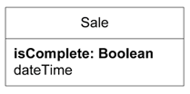
Changes to the POS Domain Model

Slide 26
Operation Contracts Within the UP
Inception Contracts are not motivated during inception They are too detailed.
Elaboration If used at all, most contracts will be written during elaboration, when most use cases are written. Only write contracts for the most complex and subtle system operations.

